Slide 1
COSMIC ACCESS Workshop AWS Batch
Presented by:
Amy McVey
Atmospheric and Environmental Research
Lexington, MA
August 15, 2023

Slide 2
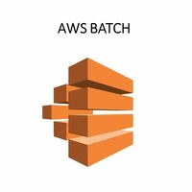
What is AWS Batch?
An AWS service which auto-scales and queues jobs based on user specifications.
With a Batch environment and architecture setup, the user simply submits the desired jobs ranging from 1 – 1000s.
The user can set up the architecture to fit their workflow as needed and to be optimized for both wall time and cost.
This is a quick way to run many simultaneous independent jobs.

Slide 3
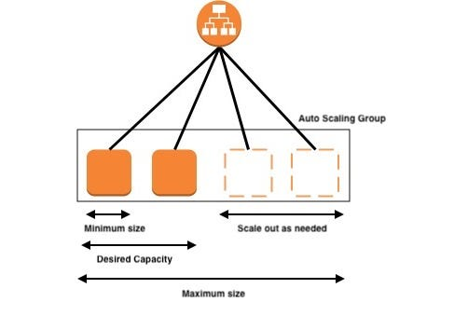
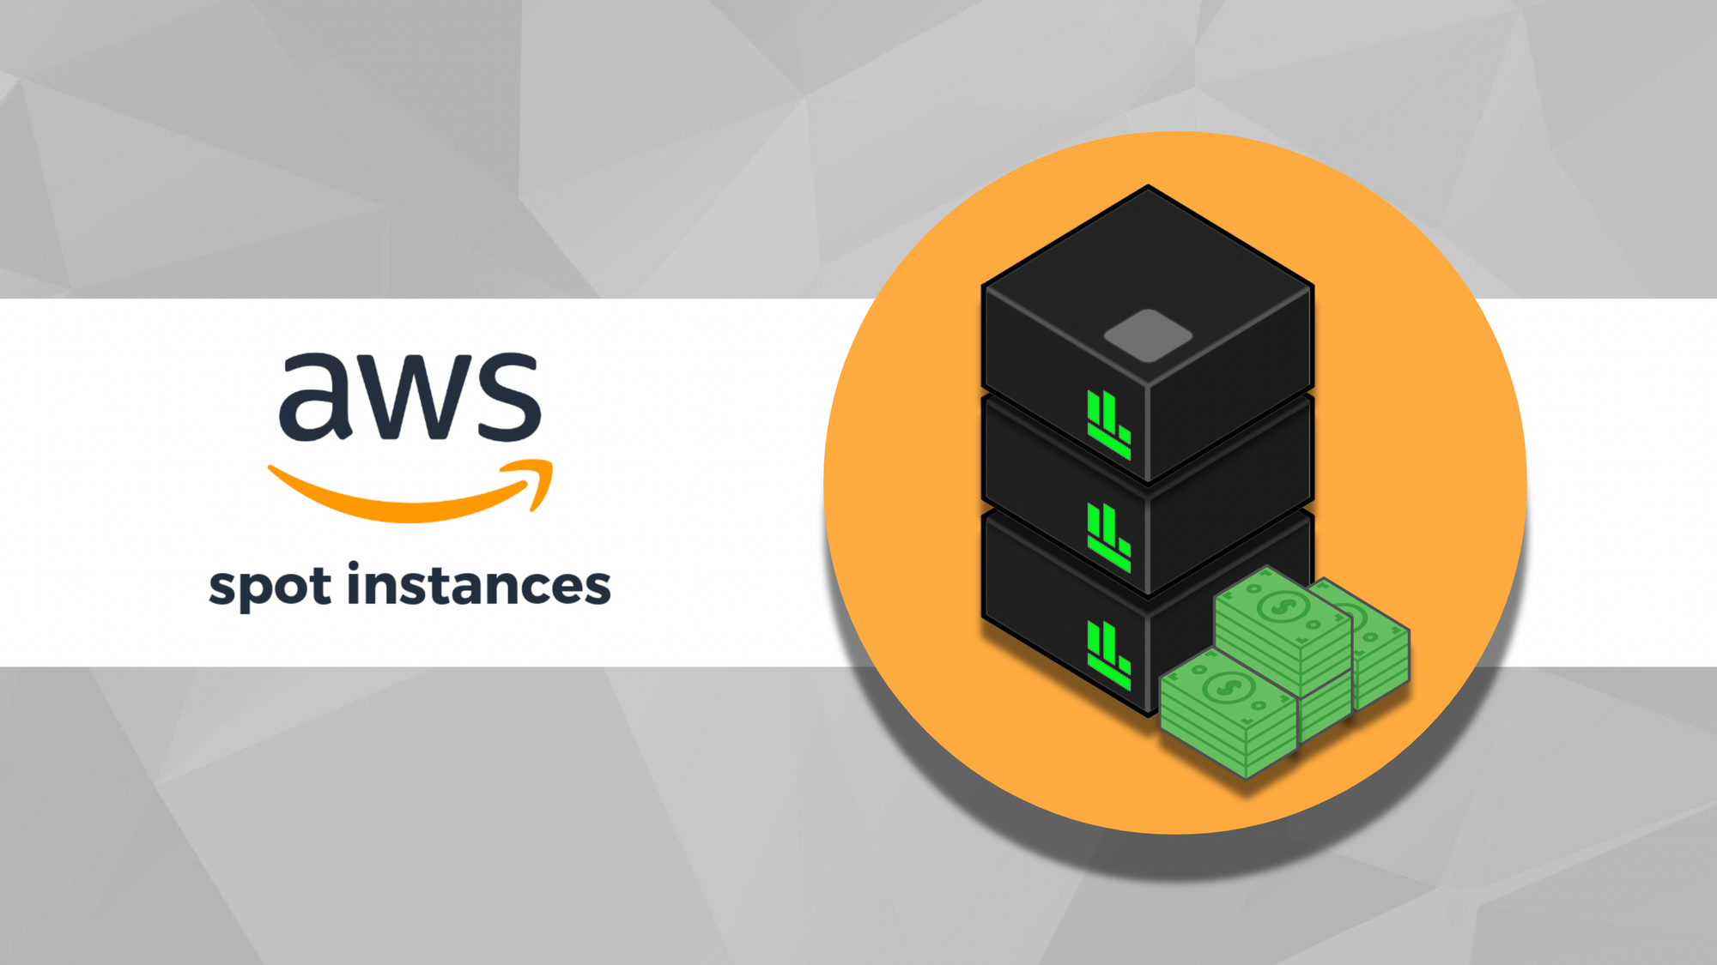
Benefits of Batch
With Auto Scaling, the EC2 starts when you request a job and terminates when the job is done. This limits wasted resources.
Using Docker containers/images each job has its own siloed environment, allocated compute and RAM as well as local storage. This is perfect for local calculations then saving the final data elsewhere, reducing the network read/write.
Option for SPOT pricing, which is cheaper EC2 instances, but they can be interrupted or terminated based on demand. If your workflow is built to easily be restarted this option can save up to 70% in costs.
Easy to track jobs and logs to initiate additional workflows or possibly debug current ones.
All of the above can save on costs.

Slide 4
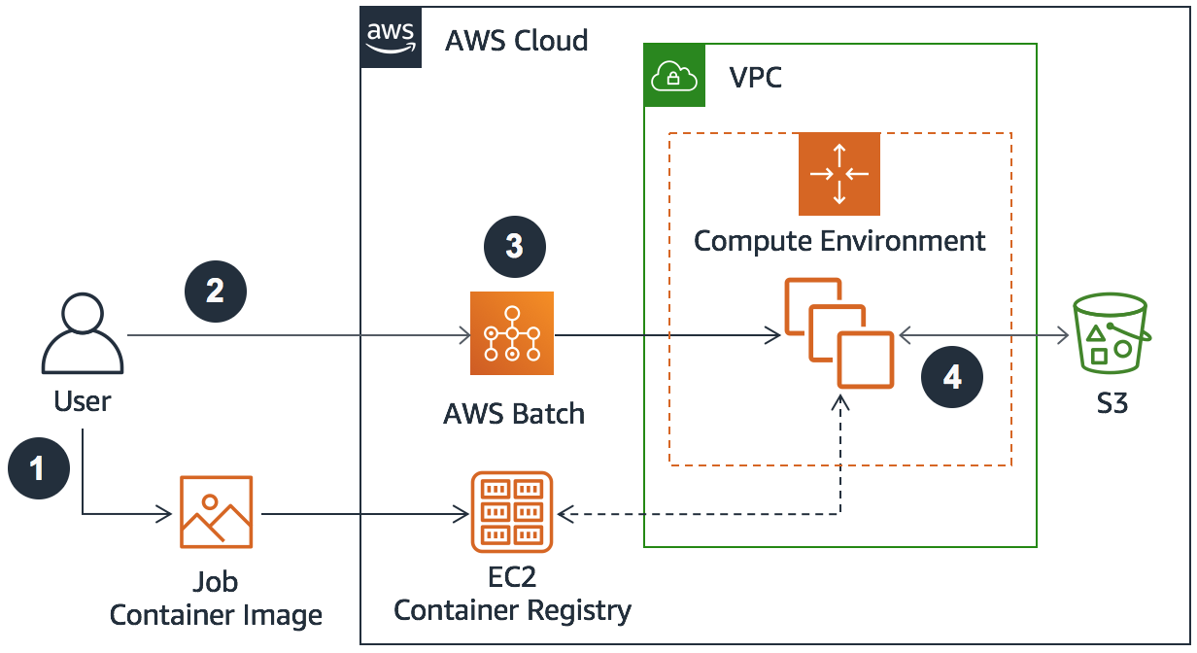
AWS Components to Batch
Elastic Container Registry (ECR) – Where the docker image lives.
Launch Template (EC2) – Any startup commands for the EC2.
Job Definition (Batch) – Naming the setup of docker image, launch template, mount points and default commands.
Job Queue (Batch) – Scheduling queue where jobs will wait until resources are available. Each job queue is connected to a compute environment
Compute Environment (Batch) – Defined environment stating what IAM roles and security groups the EC2s will inherit and the amount of available cpus allowed.
Security Groups (EC2) – Provides network permissions to resources in the respective compute environment.
Roles and Policies (IAM) – Provides policy permissions to access other AWS services.
Permanent Data Storage (S3) – As all batch jobs run on ephemeral EC2s, any data created will be lost when the job is complete unless stored outside the EC2. Copying data so S3 is one solution.

Slide 5

Terraform – Infrastructure as Code
Provides the ability to create and destroy resources based on parameters and code.
This makes it easy to copy and update complex architecture easily.
Similar to AWS CloudFormation, but developed by Hashicorp.
Example: You want to spin up and EC2.
By Hand
In the AWS console via the browser, you would need to visit the EC2>>Security Group page and create one, saving the name.
Then create the IAM policy, IAM role and finally the EC2 all in separate browsers.
To remove all these resources, you would have to go back to each respective browser (remember the name of the resource) and delete it.
With Terraform
Create code for the EC2, security group, IAM roles and policies. (You can also keep naming schemes consistent)
Run the Terraform executable and wait for the resources to exist
To remove all resources, it’s another Terraform command.

Slide 6
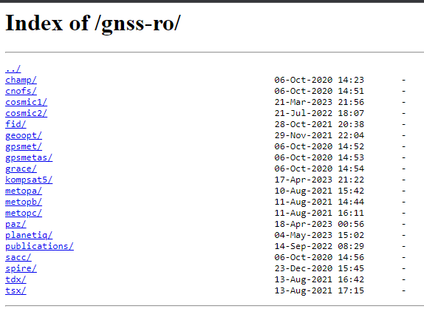
Demo - UCAR RO Live Update
Purpose:
Ingest and reformat new RO data into the gnss-ro-data open data bucket.
Process:
Scrape of the UCAR site for new files (AWS Lambda)
Download and uncompress said files (AWS Batch)
Create a list of files to process
Submit various Batch jobs to reformat the data
Export the DynamoDB metadata table and format for the awsgnssroutils API code
Sync new files with the Open Data Registry Bucket (including table metadata)

Slide 7
Thank you, and welcome!
For more information, please contact
Amy McVey
Group Manager
amcvey@aer.com
+1 (781) 761-2246

